Slide 1
AWS and the Open Source
Database Community
Madelyn Olson
Principal Engineer
AWS

Slide 2
Our customers love running open source databases on AWS.
Notes:
Set the tone. This is about community contribution, not product marketing.
Show some slides about how we

Slide 3
We contribute upstream to support our customers.
Notes:
Set the tone. This is about community contribution, not product marketing.
Show some slides about how we

Slide 4
PostgreSQL Contributions
Vacuum performance improvements (PG 17)
Reduce replication overhead after upgrade (PG 17)
Autovacuum worker config changes no longer require restart (PG 18)
Radix-based sorts for better performance (PG 19)
Notes:
Our customers told us the same thing. VACUUM pain. Upgrade fear. So we worked with the community.
Broadly Vaccuuming is faster. Primarily when hitting the transaction ID limit, that is the 6x.
Logical replication. After major versions, replication slots were invalidated. Now they are not, replicas can "PSYNC".
Chan

Slide 5
PostgreSQL Contributions

Slide 6
MariaDB Contributions
Vector search performance — 5× faster inserts, 73% less storage (MariaDB 11.8)
Storage-full conditions no longer corrupt binlogs or break replication (MariaDB 11.8.6)
Audit plugin security hardening — closes logging-bypass flaw (MariaDB 11.8.6)
Notes:
Not glamorous. But keeps databases safe in production. We do it upstream so everyone benefits.

Slide 7
MySQL Contributions
Upgrades no longer exhaust memory on databases with huge table counts
Background histogram updates stop flooding the error log with stale errors
Correct partition pruning when a non-key column gets a function/default value
Notes:
Smaller volume, focused on what matters most. Upgrade reliability and correctness bugs.

Slide 8
MariaDB and MySQL contributions
Notes:
Smaller volume, focused on what matters most. Upgrade reliability and correctness bugs.

Slide 9
Amazon Aurora MySQL 8.4
Generally Available

Slide 10
Aurora MySQL Release Objectives
Database engine | Release type | Timeline
RDS for PostgreSQL | Minor versions | Within 7 days of community release
 | Major versions | Within 30 days of the community <major>.1 release
RDS for MySQL | Minor versions | Within 30 days of community release
 | Major versions | Within 6 months of community <major>.1 release (Oracle MySQL LTS majors)
RDS for MariaDB | Minor versions | Within 30 days of community release
 | Major versions | Within 3 months of community’s first patch release
Aurora PostgreSQL | Minor versions | Within 3 months of community release
 | Major versions | Within 8 months of the community <major>.1 release
 | Aurora LTS per major | Within 12 months of Aurora major GA
Aurora MySQL | Minor versions | Within 3 months of community release
 | Major versions | Within 12 months of community <major>.1 release (Oracle MySQL LTS majors)
 | Aurora LTS per major | Within 12 months of Aurora major GA
https://aws.amazon.com/blogs/database/knowing-when-new-open-source-database-engine-versions-release-on-amazon-aurora-and-amazon-rds/
Notes:
This is the transparency play. We are publishing these so customers can plan upgrades. Hold us accountable. We want to do better than before.
Steal this table instead: https://aws.amazon.com/blogs/database/knowing-when-new-open-source-database-engine-versions-release-on-amazon-aurora-and-amazon-rds/

Slide 11


Did you hear about Valkey?
Fully compatible with Redis OSS 7.2
Vendor Neutral
BSD-3 Licensed
Built by contributors in the open source community
Notes:
Three key points about Valkey:
1. It’s fully compatible with Redis OSS 7.2, and will always be.
2. It’s backed by the linux foundation, so it will remain open-source and vendor neutral.
3. It has a diverse backing. There are six technical steering members, from six different companies.

Slide 12
Valkey Contributions
Improved vertical scaling with new I/O threading architecture
Implemented support for full text search indices
Added support for hybrid indices, allowing for both vector and full text queries
Added support for bloom filters as new data type
Notes:
Google built the vector search base engine. We added full-text search, tag queries, numeric ranges, and aggregations on top. Bloom filters are a separate module for probabilistic membership testing. Together these make Valkey more than a cache.

Slide 13
Valkey contributions
Notes:
Smaller volume, focused on what matters most. Upgrade reliability and correctness bugs.

Slide 14
Amazon ElastiCache for Valkey 9.0
Generally Available

Slide 15
Open source security contributions
AWS RDS Red Team: Security Engineers aka Hackers in Residence
  Active Security Honeypot for MySQL and PostgreSQL: protecting databases from ransomware attacks – Learn more on Thursday
Contribute the security findings to opensource / community
MySQL/MariaDB
PostgreSQL
Valkey
CVE-2023-21980
CVE-2024-21096
CVE-2025-30722
CVE-2025-8714
CVE-2026-21864
Notes:
Contributing capabilities into open source engines. Your DB should handle AI without a new service.
Contributing to the AI space.
Vector is a feature of a database.
Looking for novel methods and vectors for security issues

Slide 16
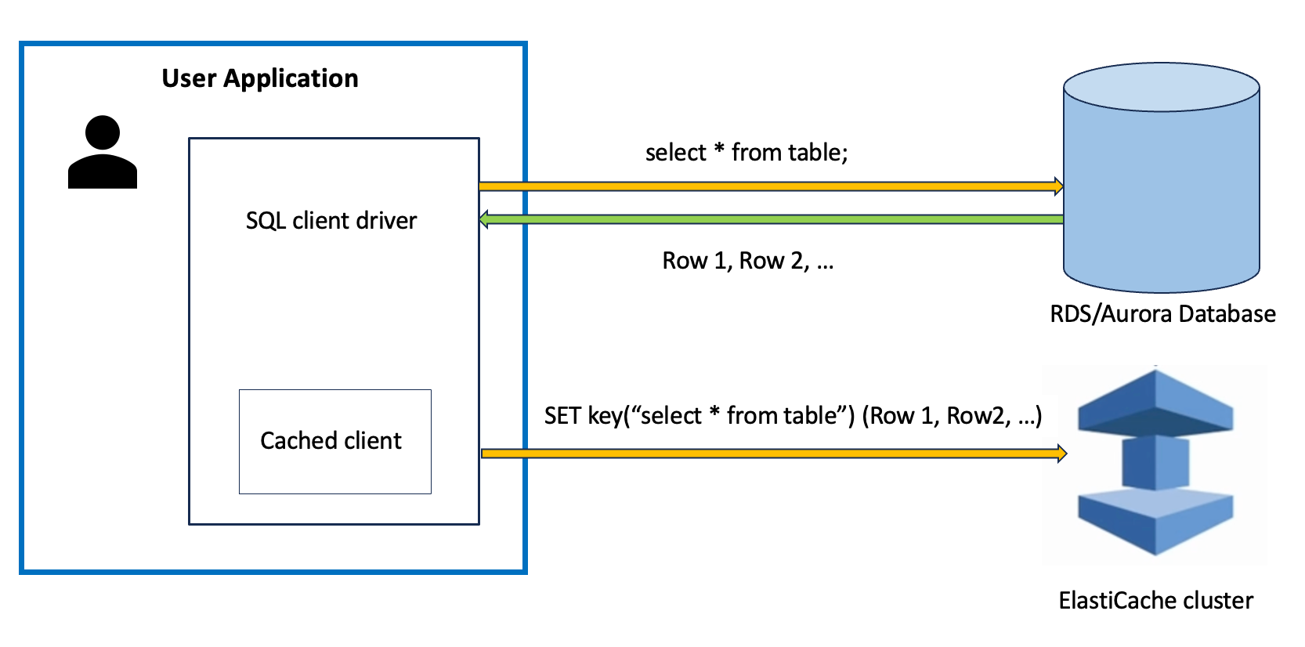
Improving integrations between databases
https://aws.amazon.com/about-aws/whats-new/2026/03/aws-jdbc-caching-with-valkey/
Notes:
Contributing capabilities into open source engines. Your DB should handle AI without a new service.
Contributing to the AI space.
Vector is a feature of a database.

Slide 17
Contributions enabling AI workloads
pgvector extensions for PostgreSQL
HNSW optimization for MariaDB Vector
Search module for Valkey
Notes:
Contributing capabilities into open source engines. Your DB should handle AI without a new service.
Contributing to the AI space.
Vector is a feature of a database.

Slide 18
How AWS contributes to the community
Be current with the community
Invest in the sustainability of projects
Build innovation upstream
Notes:
Contributing capabilities into open source engines. Your DB should handle AI without a new service.
Contributing to the AI space.
Vector is a feature of a database.

Slide 19
Thank you
Madelyn Olson
Principal engineer
AWS

